Slide 1

#LifeKoKaroLift
SGC Coaching : Session 5
Model Selection
Session By: Shambhu Gupta

Slide 2
Agenda: Session 2
Model Selection
Metrics Used for Model Evaluation
Demo
Model Evaluation
Q & A

Slide 3
Model Selection
Simple Model
A Model with fewer parameters should be preferred. (Occam’s Razor)
Simpler models are usually more ’generic’, complex models are more likely to overfit
Simple models have low variance, high bias.
Simple models are more robust
Overfitting
refers to a model that models the training data too well.
Overfitting happens when a model learns the detail and noise in the training data to the extent that it negatively impacts the performance of the model on new data. This means that the noise or random fluctuations in the training data is picked up and learned as concepts by the model. The problem is that these concepts do not apply to new data and negatively impact the models ability to generalize.

Slide 4
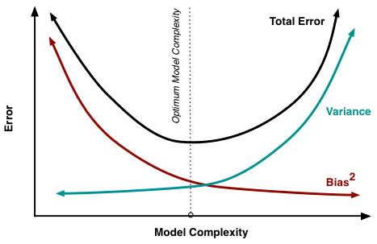
Model Selection
Bias Variance Trade Off
The goal of any supervised machine learning algorithm is to achieve low bias and low variance. In turn the algorithm should achieve good prediction performance.
Bias: The bias is known as the difference between the prediction of the values by the ML model and the correct value.
That means: High Bias – Underfitted model
Variance:
The model with high variance has a very complex fit to the training data and thus is not able to fit accurately on the data which it hasn’t seen before.
That means: High Variance – Overfitted model

Slide 5
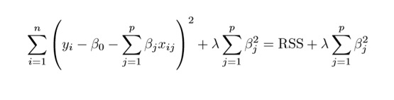
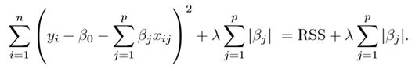
Model Selection
Regularization
Regularization is a process used to create an optimally complex model, i.e. a model which is as simple as possible while performing well on the training data. In other words, this technique discourages learning a more complex or flexible model, so as to avoid the risk of overfitting.
> Cost = RSS + Penalty or Regularization term
Example:
- Regularization term (Ridge, Lasso)
- Pruning (Decision Tree)
- Dropout

Slide 6
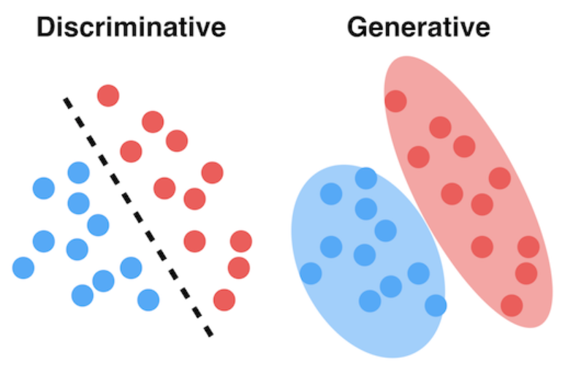
Naïve Bayes VS Logistic Regression
Naive Bayes
Used for classification problems
Algorithm’s Learning mechanism : Generative model
Model assumptions: assumes all the features to be conditionally independent
Logistic Regression
Used for classification problems
Algorithm’s Learning mechanism : Discriminative model.
Model assumptions: splits feature space linearly, and typically works reasonably well even when some of the variables are correlated.
https://www.analyticsvidhya.com/blog/2021/07/deep-understanding-of-discriminative-and-generative-models-in-machine-learning/

Slide 7
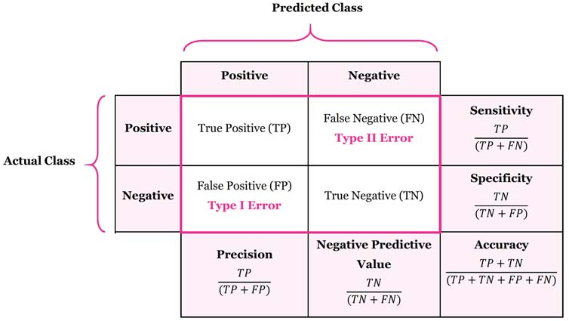
Confusion Matrix
Confusion Matrix is a tool to determine the performance of classifier. It contains information about actual and predicted classifications.
True Positive (TP) is the number of correct predictions that an example is positive which means positive class correctly identified as positive.
False Negative (FN) is the number of incorrect predictions that an example is negative which means positive class incorrectly identified as negative.
False positive (FP) is the number of incorrect predictions that an example is positive which means negative class incorrectly identified as positive.
True Negative (TN) is the number of correct predictions that an example is negative which means negative class correctly identified as negative.
Q: How does a confusion matrix looks for multi-class problem? Solution

Slide 8
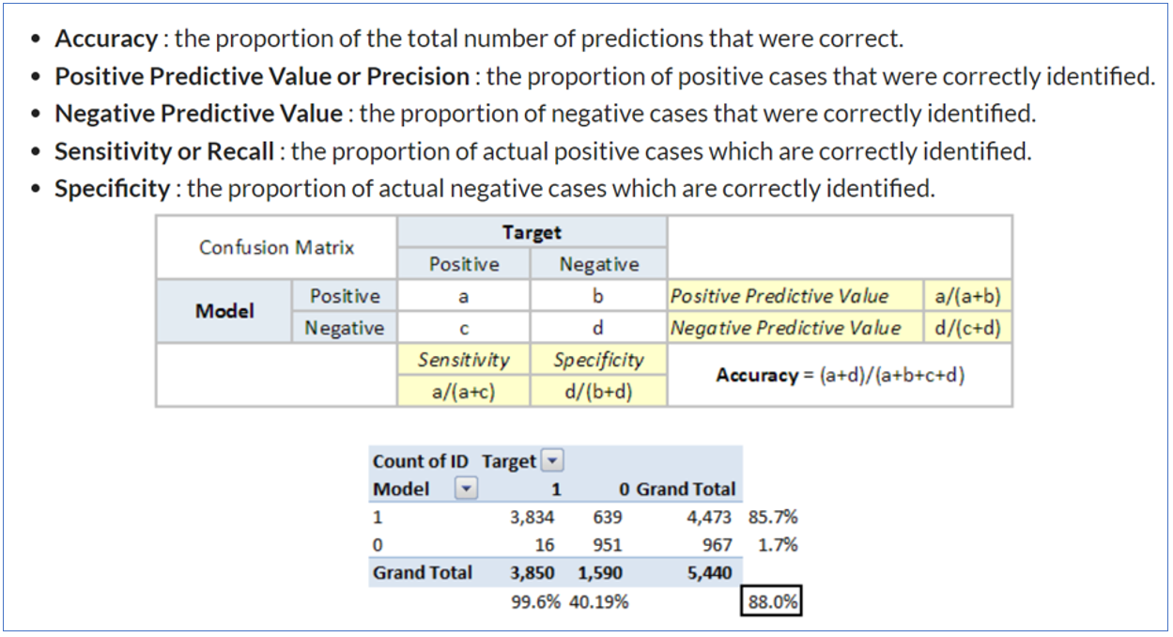
Model Evaluation: Classification Metrics

Slide 9
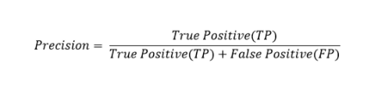
Precision
Precision is the ratio of true positives to the total of the true positives and false positives. Precision looks to see how much junk positives got thrown in the mix. If there are no bad positives (those FPs), then the model had 100% precision. The more FPs that get into the mix, the uglier that precision is going to look.

Slide 10
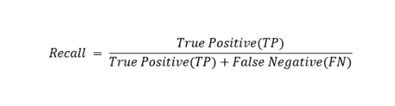
Recall
Recall goes another route. Instead of looking at the number of false positives the model predicted, recall looks at the number of false negatives that were thrown into the prediction mix.
The recall rate is penalized whenever a false negative is predicted. Because the penalties in precision and recall are opposites, so too are the equations themselves. Precision and recall are the yin and yang of assessing the confusion matrix.

Slide 11
When to use Accuracy/Precision/Recall
For a perfect model, we expect a diagonal matrix. The off-diagonal elements (the falses) are mistakes made by our model, so we would like them to be as few as possible.
Accuracy: When you have balanced datasets and you give the same importance to 0s and 1s. Not a good choice for Multi-Class target variable.
Precision: When we want the prediction of 1 (TP) to be as correct as possible. Example: Marketing campaign.
Recall: When we want our model to spot as many real 1 as possible. i.e. FN is very Costly. Example: fraud detection and disease detection. A false negative patient may become contagious and it’s not safe.

Slide 12
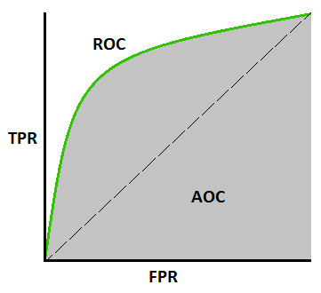
AUC - ROC Curve
Performance measurement for the classification problems-
ROC is a probability curve
AUC represents the degree or measure of separability (How much the model is capable of distinguishing between classes)
Higher the AUC, the better the model is at predicting 0 classes as 0 and 1 classes as

Slide 13

Ask your Questions !
Questions/ Doubts?

